Slide 1

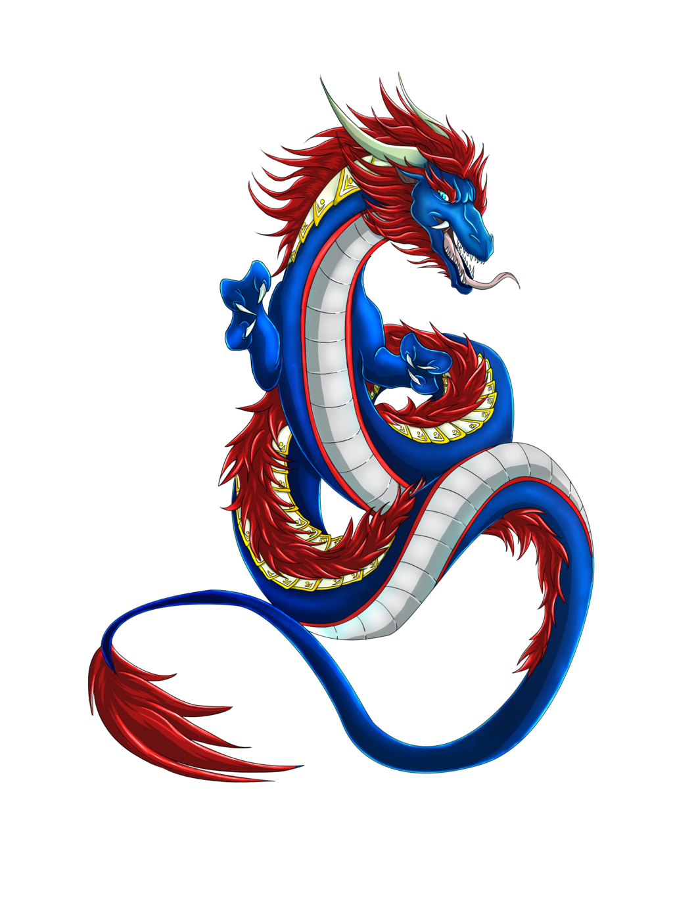

Hunting for cloudy SSRFs
Cloudy dragons hiding in plain sight
Nicolas Joly - @n_joly
MSRC Vulnerabilities and Mitigations Team
This presentation is for informational purposes only. MICROSOFT MAKES NO WARRANTIES, EXPRESS OR IMPLIED, IN THIS SUMMARY.

Slide 2
Why that talk?
Memory corruptions are just a part of the vulnerability landscape
Pocs are quick to craft, exploits take 100s of hours of research
They require exceptional skills
They do make good talks though
SSRFs are much simpler issues, scalable and devastating
Leak tokens, data
Target local endpoints, lead to abuse other issues
Some hide in plain sight, how to find them?
Some examples on AKS
A recurrent Office Online case

Slide 3
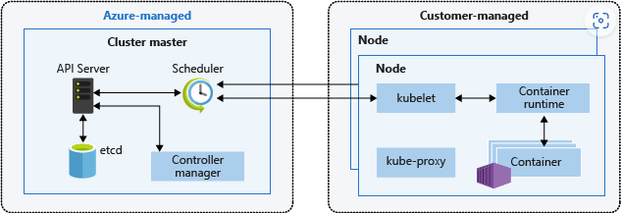
AKS – Azure Kubernetes Services
Kubernetes cluster architecture:
Communications between the nodes and Azure are tunnelled
Learn more here
Nodes are on the customer side, anything can happen in there
If something happens in the control plane that’s a different story
This was the scope of our review

Slide 4
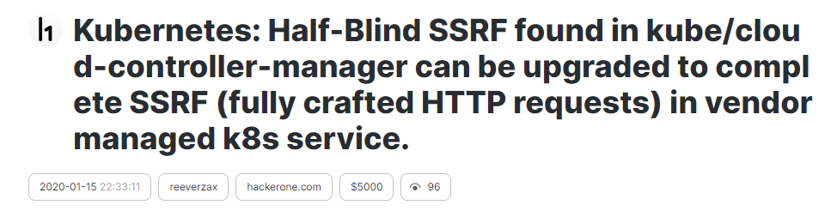
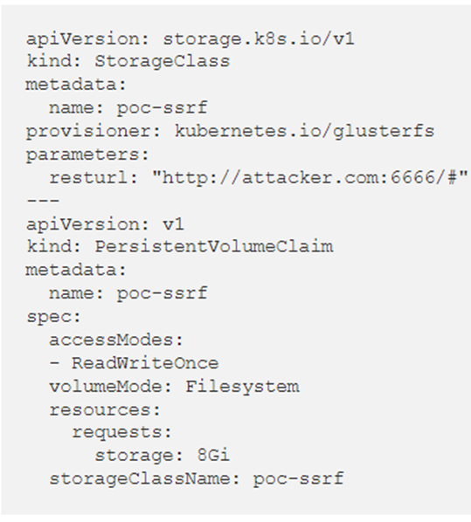

AKS – Previous research
When it’s not only about a Kubernetes CVE… | by Breizh Zero-day Hunters | Medium
What was the idea behind?
Load a malicious storage volume causing SSRF
Abuse a bug in Golang (CRLF injection) to desynchronize requests
Scrub the logs in LogAnalytics and look for unexpected HTTP requests
Extra verbosity resulted in leaking tokens or other secrets

Slide 5
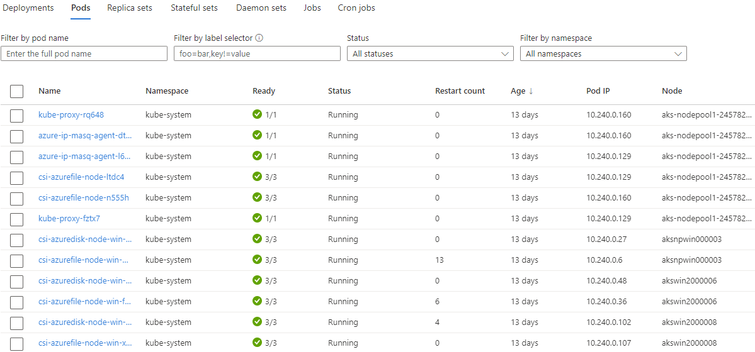
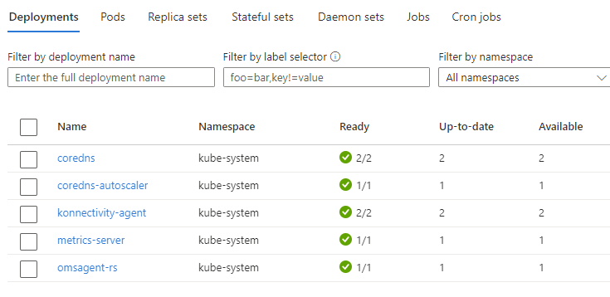
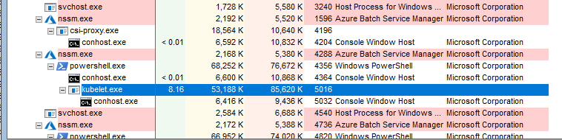
AKS – Where to go next?
Look at default deployments and pods?
Target API-Server?
Look at log ingestion?
Let’s have a look at a Windows node, see what’s going on there
Add next Procmon/ProcessXP/Wireshark/BurpSuite… and Windbg!

Slide 6
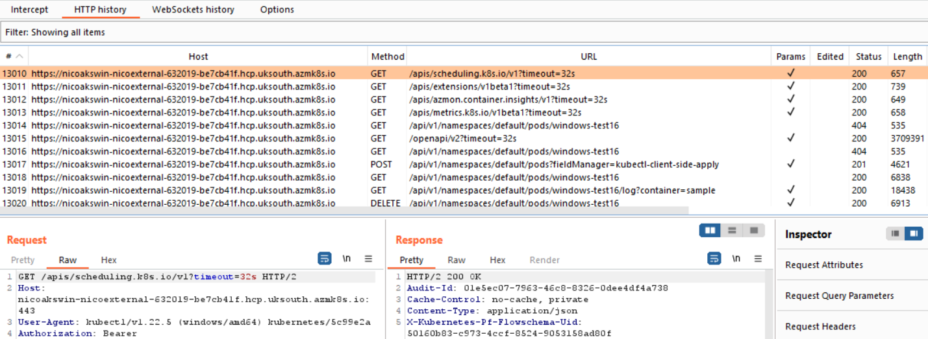
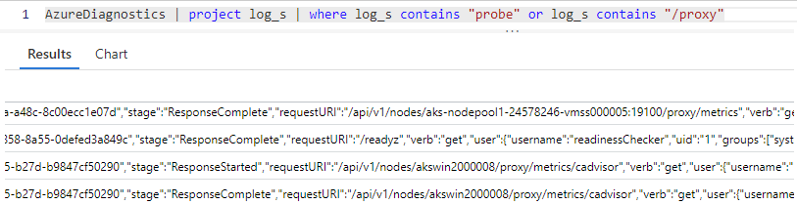
AKS – Looking at HTTPS traffic
Set up Burp, could see all the requests coming to the API-Server
Played with kubectl, crafted pods that behaved weirdly
Looked for request smuggling patterns
Basically found nothing ☹ ☹
Then realized that there was a lot that I wasn’t seeing
Probe requests
Metrics requests
Where are those?

Slide 7
AKS – Looking at HTTPS traffic
HTTPs traffic goes both ways:
From kubelet to api-server ( )
From the api-server to kubelet through a tunnel ( )
There, HTTP_PROXY is useless
How do we see that traffic?
Fired Windbg and took a trace (Kubernetes 1.21.7)
Put breakpoints just before requests were encrypted/decrypted
bp kubelet+0x1a52b9 ".printf \"WSAsend:\n\";db @rsi L100;.printf \"WSAsend END:\n\";g"
bp kubelet+0x1a72c7 ".printf \"WSArecv:\n\";db poi(@rsp+10) L100;.printf \"WSArecv END\n\";g"

Slide 8
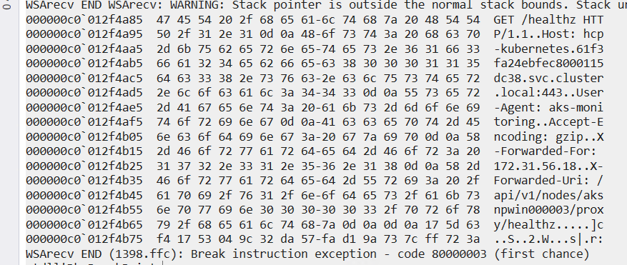
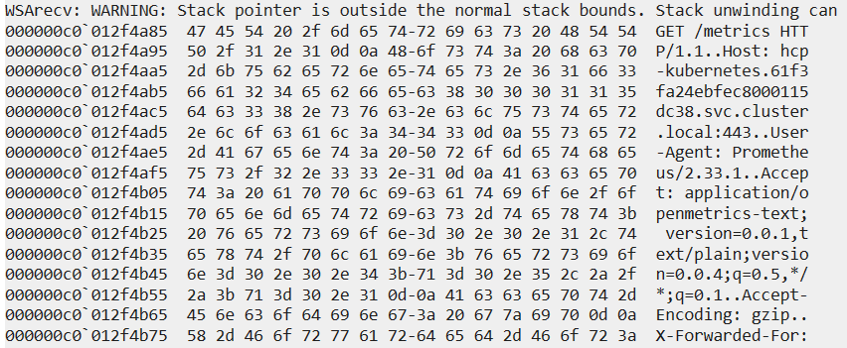
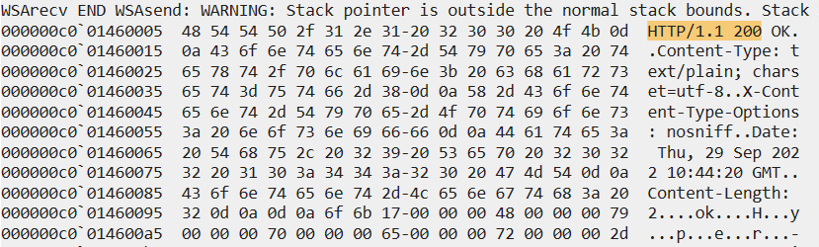
AKS – Looking at HTTPS traffic

Slide 9
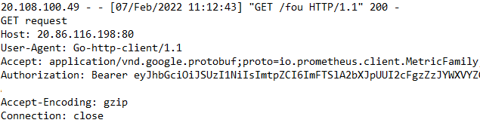
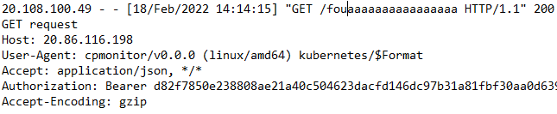
AKS – Looking at HTTPS traffic
Easy to intercept and rewrite responses with Windbg breakpoints
bp kubelet+0x1a52b9 ".printf \"WSAsend:\n\";db @rsi L@r9;.printf \"WSAsend END:\n\";j (poi(@rsi)==0x312e312f50545448) 'ea @rsi \"HTTP/1.1 301 ok\r\nLocation: http://nico.nico.com/fou\r\nContent-Length: 0\r\n\r\n\r\n\"; g'; 'gc' "
Leads to SSRF on the control plane (fixed in March 22):

Slide 10
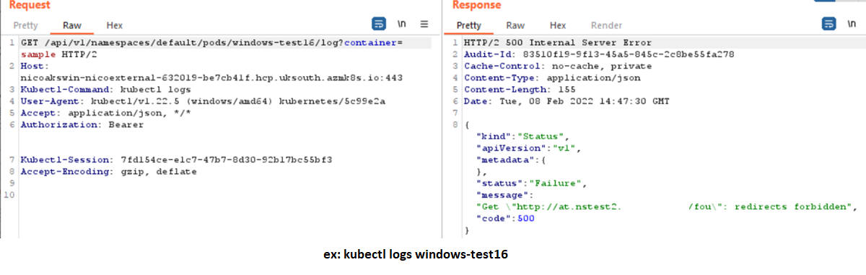
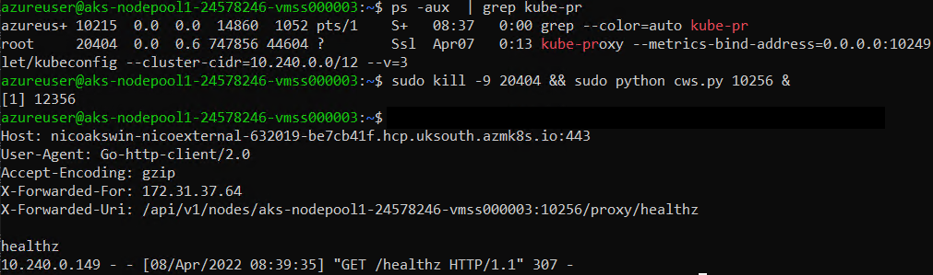
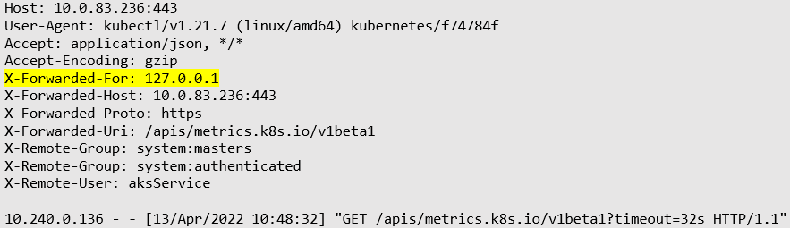
AKS – Looking at HTTPS traffic
That pattern was not present everywhere
A similar bug with kube-proxy
And one with Metrics-Server (CVE-2022-3172)
Running as an extension under /apis/metrics.k8s.io
Can be overridden to run a custom web server that redirects requests:

Slide 11
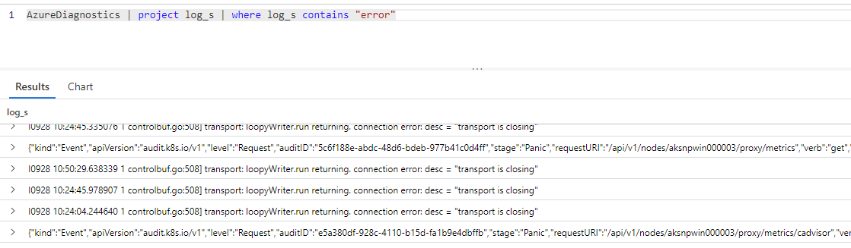
AKS – Looking at HTTPS traffic
Impact of those SSRFs?
Disclose various tokens
Requests can also be rerouted to target other endpoints on the control plane
And today?
No more redirects, just safe panics!

Slide 12
More common SSRFs Let’s look at another example from Office

Slide 13
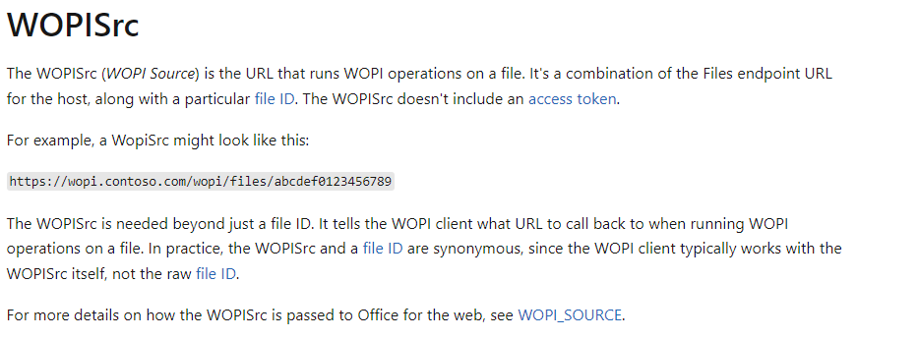
Office Apps - WOPISrc
WOPI (Web Application Open Platform Interface) and WOPISrc
Example: https://word-view.officeapps.live.com/wv/wordviewerframe.aspx?WOPISrc=MyURL
Frequent reports to MSRC mentioning that arbitrary URLs in WOPISrc causes hits in DNS logs

Slide 14
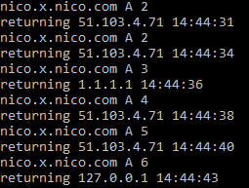
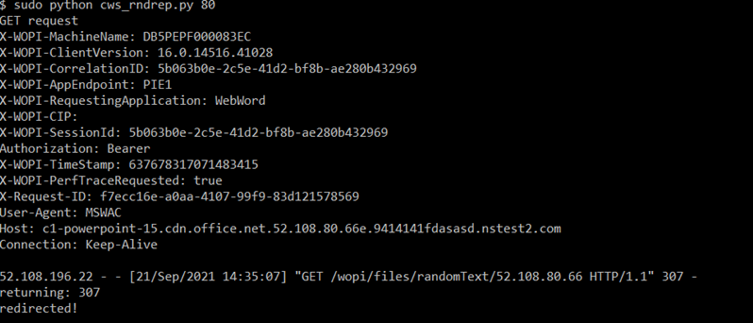
WOPISrc – bug or no bug?
A hit in the DNS logs doesn’t mean there’s a vulnerability
It means a name was resolved
And likely there’s a filter on the IP, or on the hostname (regexp?)
Ways to get around?
DNS TOCTOU, A or AAAA records with ttl=0
Occasionally returns unexpected IPs
Taviso opened sourced his own tool… 7 years ago
Try an open redirect
Fixed in Oct 21
Clearly a common pattern

Slide 15
Questions!

